Slide 1

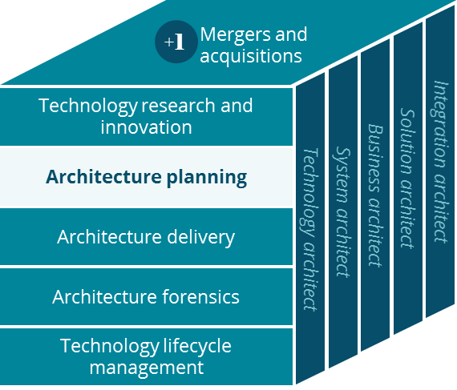
PBM - NovoLogix Business Canvas
Architecture Planning

Slide 2
Business Canvas
NovoLogix
Key Partnerships
Key Activities
Value Proposition
Customer Relationships
Customer Segment
Health Plans
Employers
Medical Rx Prior Authorizations
Prescription Claim Editing
Client Savings
Prescriber Portal
Reporting
Client
Digital
Client
Health Plans
Employers
PBMs
Silver Scripts
Insurance Co
Help Desk
Self Service Clients
Delegated
Clients
Government Employee Groups
Prescription Drug Plans (PDP)
CVS Pharmacy
SureScripts (ePA)
Managed Medicaid
Public Exchanges
Prescribers
Cover My Meds
Channels
Private Exchanges
Key Resources
Mail
E-Mail
Data Vendors
Prescribers/Drugs
Communication Vendors
Pharmacists & Pharmacy Techs
Medical Directors
Phone
Fax - Clients
Clinical Review (CRU)
Sales and Marketing
Digital
Fax - Prescribers
E-Messaging - Prescribers
Cost Structure
Revenue Streams
Pharmacists & Pharmacy Techs
Marketing & Sales
Specialty Underwriting
Medical Directors
CRU
Per Member Per Month (PMPM)
Compliance & Regulatory

